Slide 1

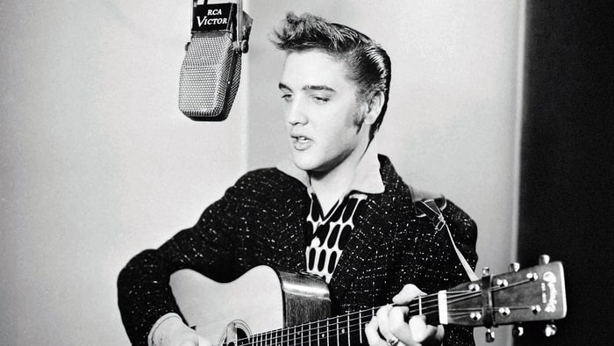

Slap Back Echo
2017
Tor Halmrast
Head of Acoustics, Statsbygg
Assoc. Prof., Univ. Oslo, Musicology
Art of Record Production, St.holm 1-3 dec 2017

Slide 2
Jeg har aldri vært Elvis-fan
Vanligvis: Tape/elektronikk etterlikne naturlige fenomener
Artikkel om Elvis´s plateinnspillinger:
Hvordan man «naturlig» prøvde å etterlikne
noe som først ble lagd «på tape»
SUN STUDIOS, Memphis
RCA, Nashville og Hollywood

Slide 3
Interesse:
Klangfarge-endringer pga nære refleksjoner
Et ekko er ikke et ekko
Direktivitet av ekko
Signalbehandling: Cepstrum, Autocorrelation etc.

Slide 4
Sam Phillips
The Memphis Recording Service.
SUN Studios
60 -120 milliseconds?
At 60 Milliseconds, you don’t hear much doubling,
but everything sounds a little thicker and fatter
At 120 Milliseconds you are REALLY starting to hear
the distinct doubling of the sound.
150 to 200ms with
just one repeat at
almost the same amplitude as the original signal.
(75 to 250 milliseconds), with little or no feedback.
re-feeding the output signal from the playback head tape recorder to its record head
2 Ampex 350 recorders:
The physical space between heads,
the speed of the tape, and
the chosen volume being
the main controlling factors.
530ms will be too long, 163 ms seemed to sound about right.
…a little either side of a 1/16 note might be what it really comes down to.
Scotty Moore’s guitar-work on “That’s All Right”

Slide 5
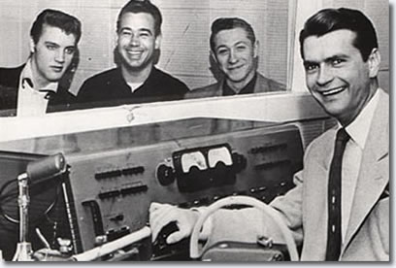
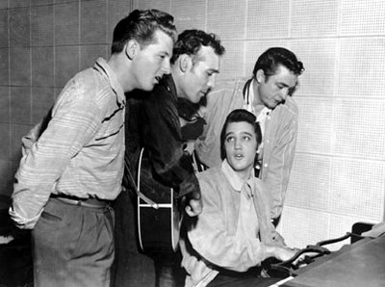
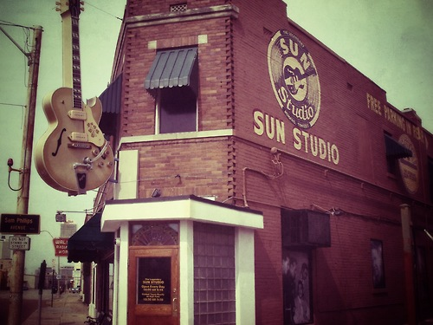
SUN Studios, Memphis
2017
Jerry Lee Lewis,
Carl Perkins
Elvis Presly
Johnny Cash
SUN STUDIOS
Dec.4th, 1956
ELVIS
Sam Philips

Slide 6
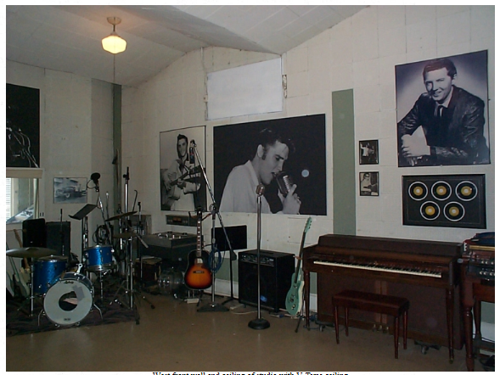
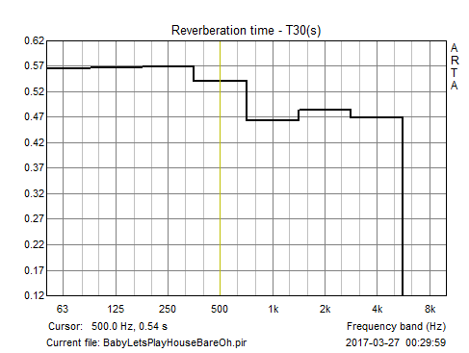
Sun Studios
Perforated gypsym
(mid-freq.-absorber)
- Bass abs.!!
T30
(from short vocal sound)

Slide 7
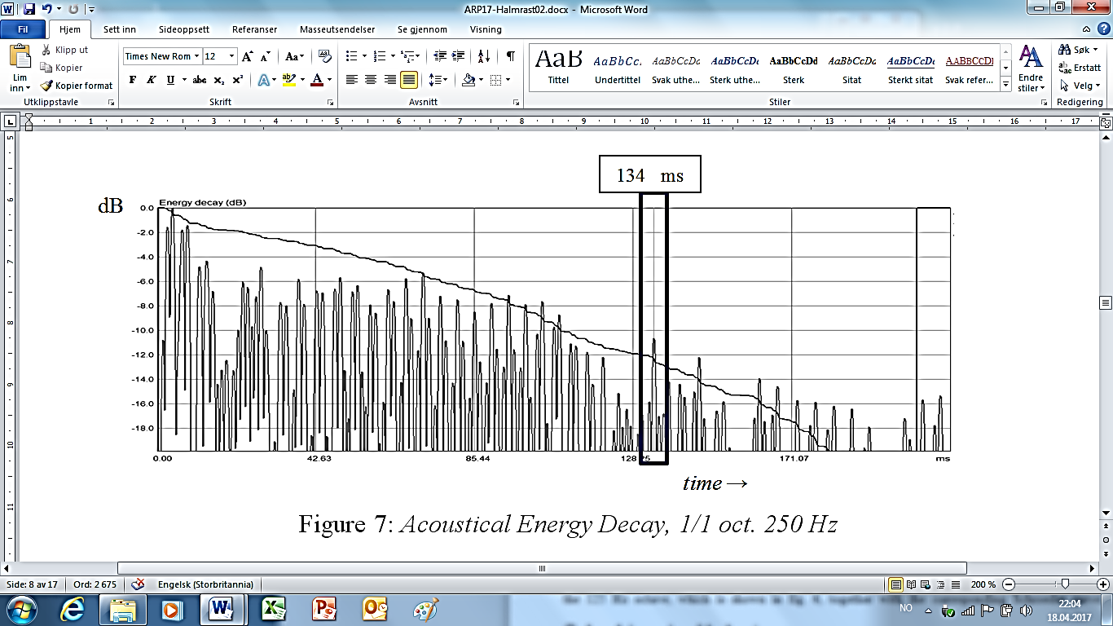
“Baby Let´s Play House”.
Acoustical Energy Decay, 1/1 oct. 250 Hz
from short voice uttering followed by “almost silence” .

Slide 8
Baby Let´s Play House
Sun Studios
Power Cepstrum (Praat):
137 ms

Slide 9
Tryin´to get to you
Sun Studios
Cepstrum (MIR toolbox)
PITCH (by Autocrrelation)
Autocorrelation (MIR toolbox)
Power Cepstrum (Praat)
137 ms
137 ms

Slide 10
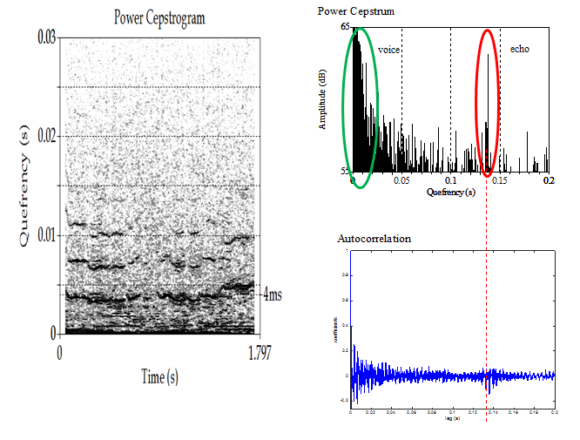

Slide 11
Tomorrow Night
Cepstrum
Autocorrelation
150 ms
Overdubbing??

Slide 12
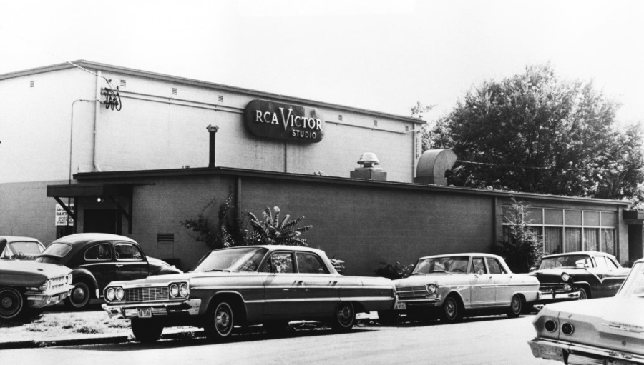
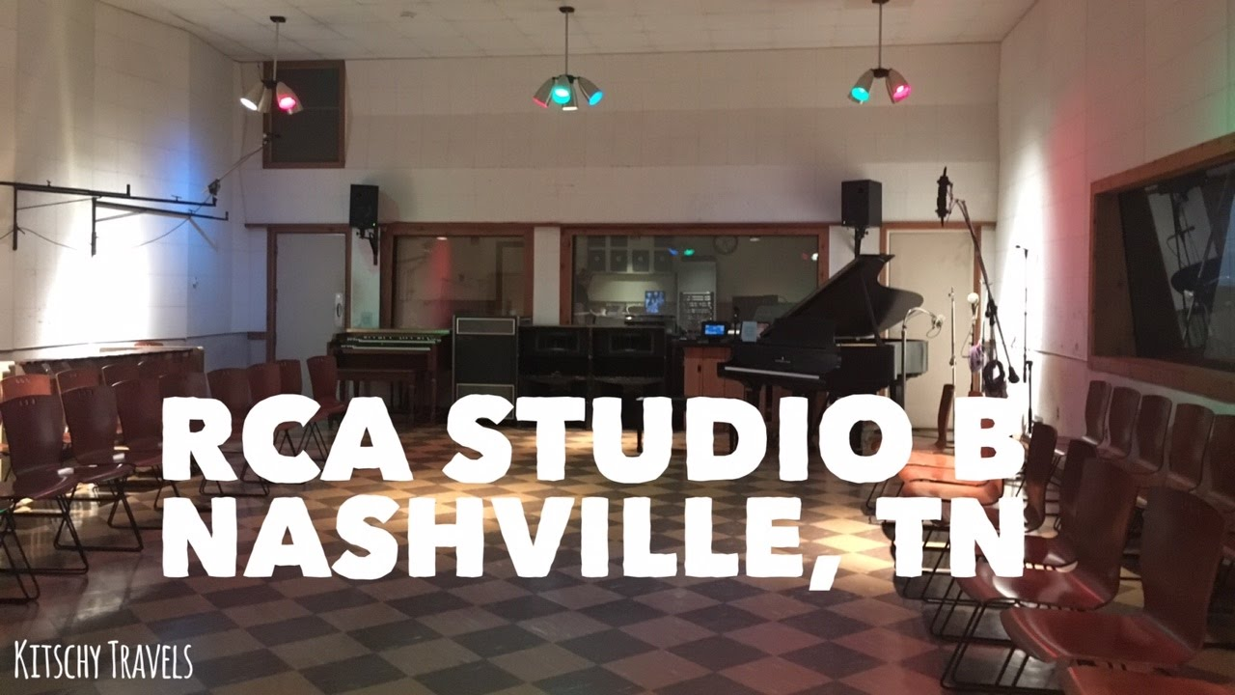
RCA

Slide 13
Elvis moved to the bigger RCA company
They did not figure out
how Sam Philips had made the Slap Back Echo
January 1956 : Heartbreak Hotel was recorded - perhaps they found out the hard way when they had to use the stairwell.

Slide 14
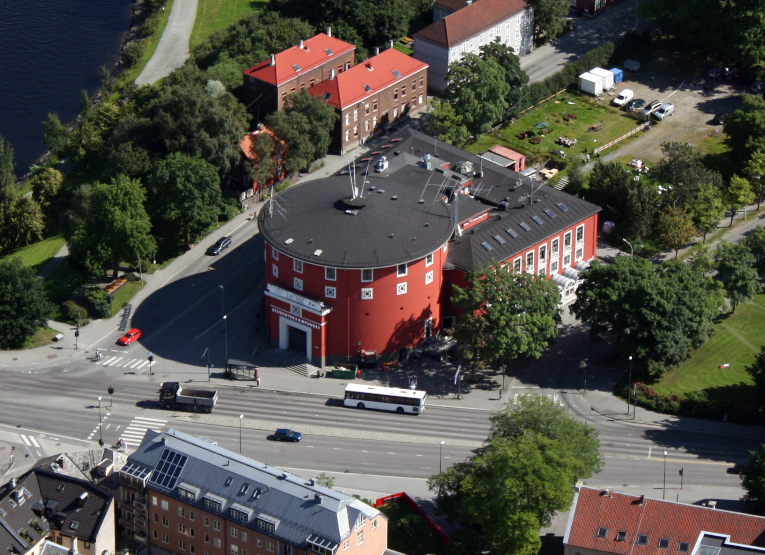

Slide 15
Heartbreak Hotel
RCA
82 msec
Tone E=330

Slide 16
RCA
deltaT=0,08 s (80 ms)
CBTB=1/deltaT=1000/80=12.5 Hz
MIGHT correspond to an echo in the length direction of a corridor with
length 27.2/2=13.6 m (if the sound travels to the «short wall» and back)

Slide 17
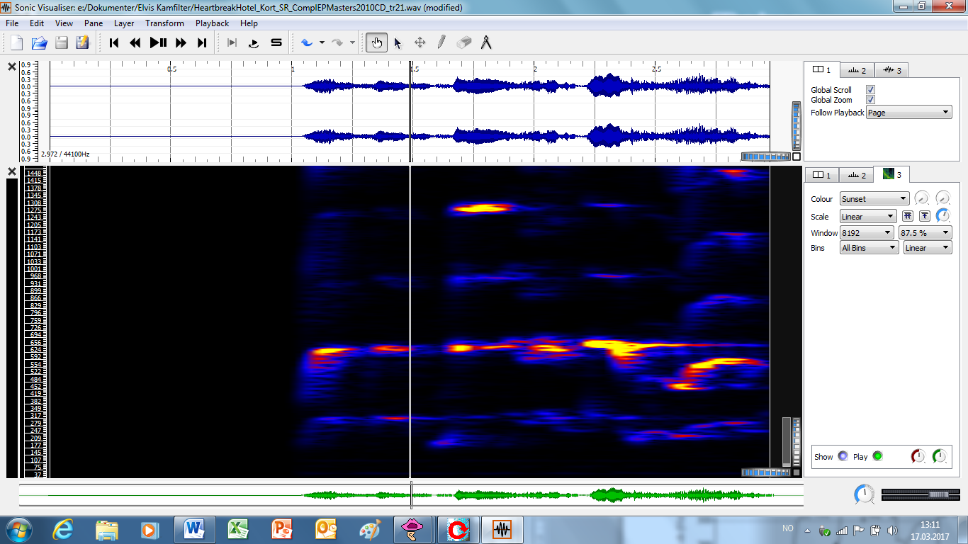
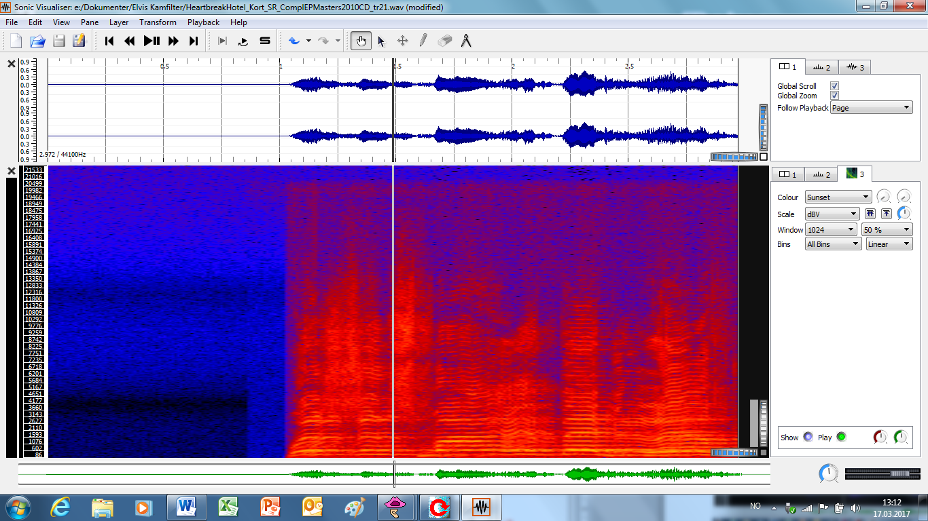
Heartbreak Hotel (cont.)
RCA
1500 Hz
75 Hz
22.000 Hz
80 Hz

Slide 18
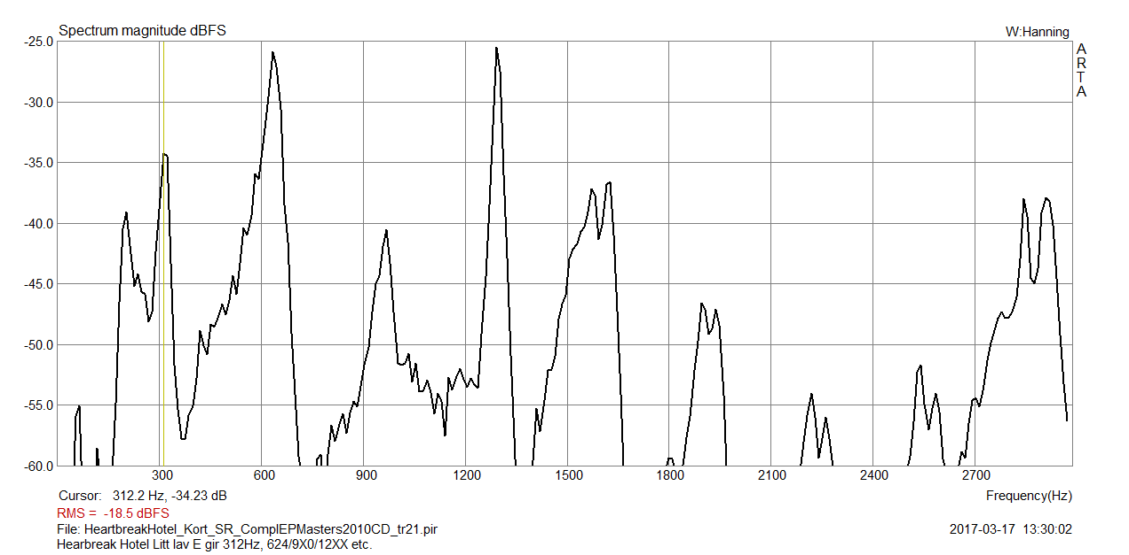
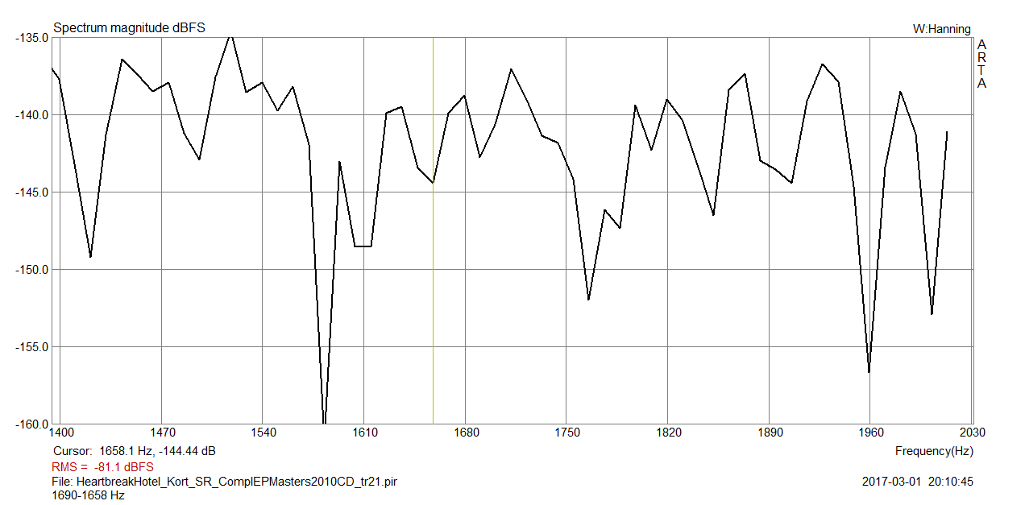
Heartbreak Hotel (forts.)
Spectrum of first part (Since my …), mostly a (somewhat low) E
No clear comb-filter(?)

Slide 19
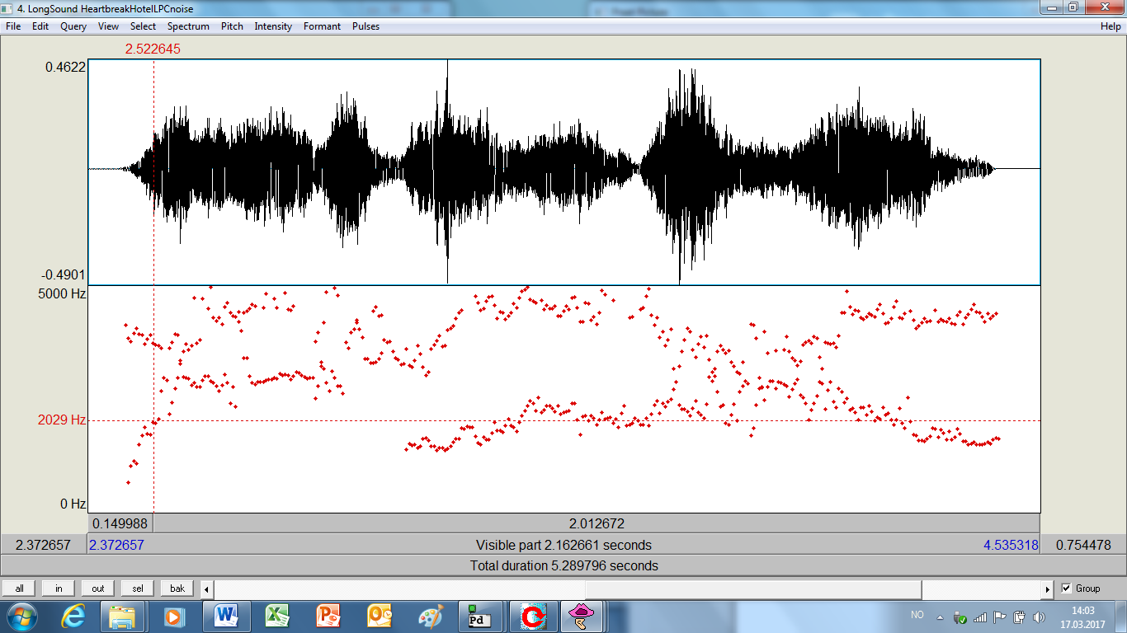
Heartbreak Hotel (cont.)
FORMANTS
(wEEEL, sIIIIInce )
Formant1/Formant2 (from litt.)
e: 402 / 2020, i: 291/2210

Slide 20
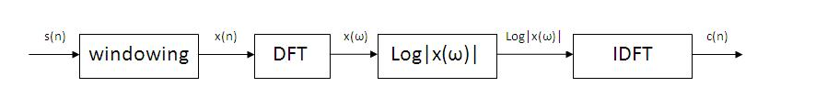
"cepstrum" =reversing the first four letters of "spectrum".
ceptrum =
the inverse Fourier transform of the log magnitude spectrum.
complex cepstrum,
real cepstrum,
power cepstrum,
phase cepstrum

Slide 21
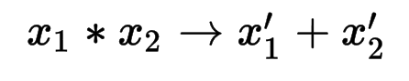
convolution of two signals = addition of their complex cepstra:
vocal excitation (pitch) and vocal tract (formants) are
additive in the logarithm of the power spectrum and
thus clearly separate.
The cepstrum projects all the slowly varying components in log magnitude spectrum to the low frequency region and fast varying components to the high frequency regions.
In the log magnitude spectrum, the slowly varying components represent the envolope corresponds to the vocal tract and the fast varying components to the excitation source.
As a result the vocal tract and excitation source components get represented naturally in the spectrum of speech.
The initial few values in the cepstrum typically 13-15 cepstral values represent the vocal tract information

Slide 22
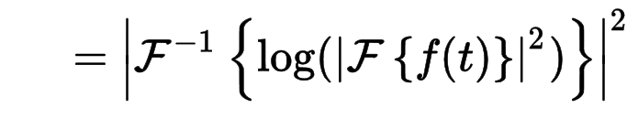
The power cepstrum =squared magnitude of the inverse Fourier transform of the logarithm of the squared magnitude of the Fourier transform of a signal
The complex cepstrum is defined as the Inverse Fourier transform of the logarithm (with unwrapped phase) of the Fourier transform of the signal. This is sometimes called the spectrum of a spectrum.
complex cepstrum of signal = IFT(log(FT(the signal))+j2πm)
(where m is the integer required to properly unwrap the angle or imaginary part of the complex log function)
Many texts define the process as FT → abs() → log → IFT,
i.e., that the cepstrum is the "inverse Fourier transform of the log-magnitude Fourier spectrum". (the difference between squaring or taking the absolute value amounts to an overall factor of 2)
SIFT
Simplified Inverse Filter Tracking algorithm
Encompasses the desirable properties of both autocorrelation and cepstral pitch analysis techniques.

Slide 23
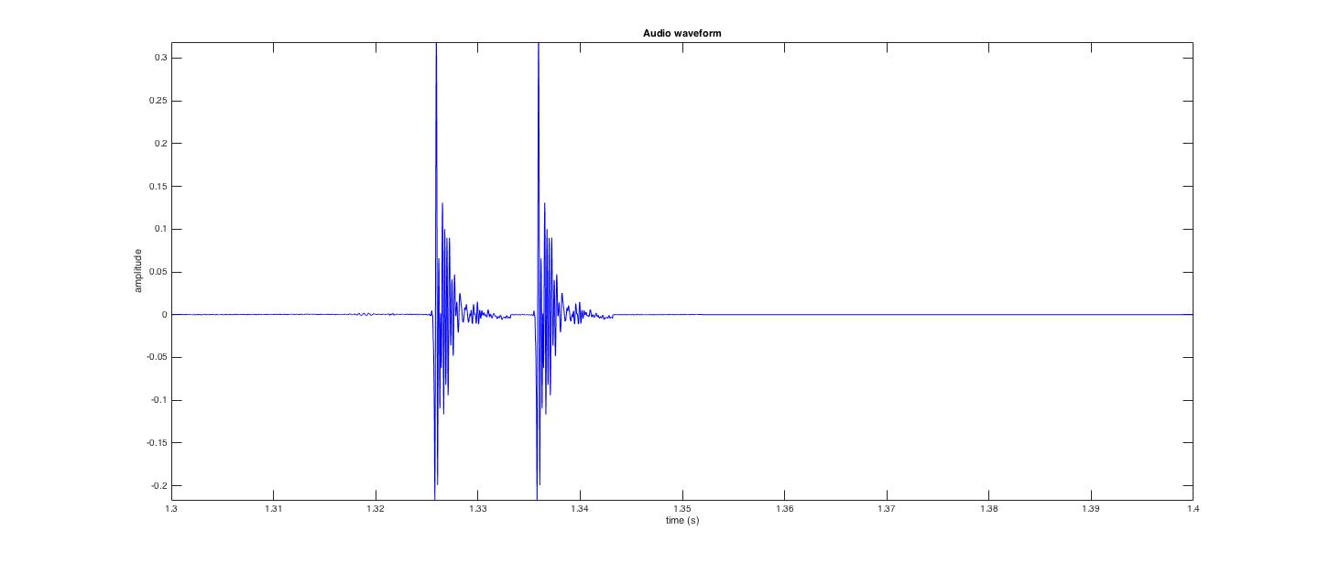
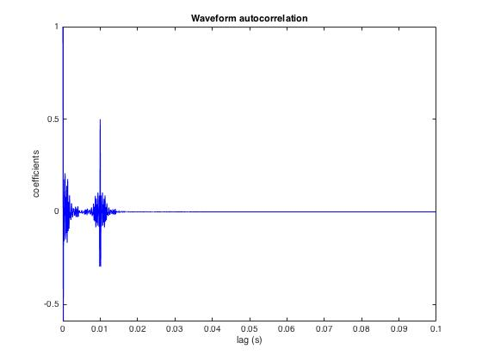
HUMAN ORAL CLICK
w/REFLECTION 10ms
FREQUENCY SPECTRUM:
Sound File
Autocorrelation
The signal «looks like itself» after 0 ms (of course)
and after 10 ms
Cepstrum
The frequency response (spectrum)
«looks like itself» every 100 Hz (which corresponds to
1/100=0.001 seconds=10 milliseconds

Slide 24
Dirac + reflection
Δt =137 ms
As for
SUN studios
SPECTRUM CBTB= 1/Δt
CBTB=1000/137=7,3 Hz (1029.3-1022)
POWER CEPSTRUM

Slide 25
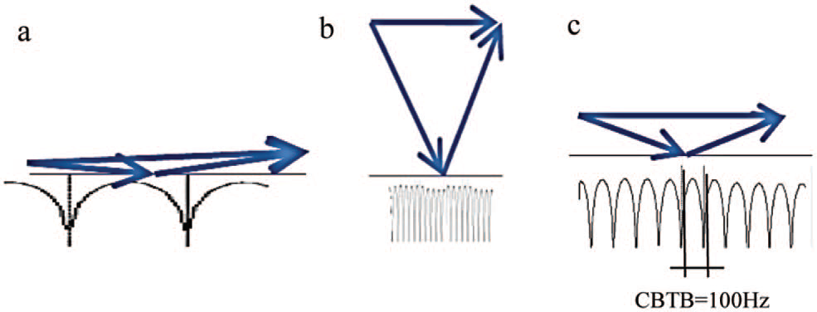
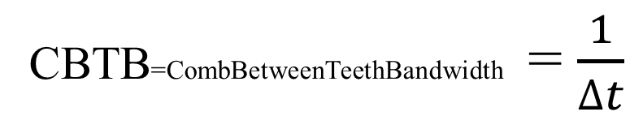
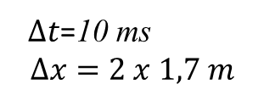
COMB FILTERS
CBTB=CombBetweenTeethBandwidth = $\frac{1}{∆t}$
DELAY:
SHORT MEDIUM LONG
$∆t$=10 ms
$$∆x=2 x 1,7 m$$
PS! For 50 ms: CBTB=1000/50=20 Hz

Slide 26
POWER CEPSTRUM
ECHO-------------------------------------------------------------------------
Fund.
Voice
For-
mants.
Room
reso-
nances
Flut-
ter
2kHz
tail
Box
Klang-
Farbe

Slide 27
POWER CEPSTRUM
ECHO--------
Fund.
Voice
Room
reso-
nances
For-
mants.
Flut-
ter
2kHz
tail
Box
Klang-
Farbe

Slide 28
PERCEIVED
COMB FILTER COLORATION?
(BOX-KLANGFARBE)
Comparing the CBTB (Comb Between Teeth Bandwidth)
with the Critical Bandwidth of our hearing organ (basilar membran)

Slide 29
SUN SlapBack
No CombColoration
Heartbreak
VeryLittleColoration
LongTallSally
CorridorColoration?

Slide 30
Slap Back Echo
Happily in MONO
Heartbreak Hotel Orig
(Hallway-reverb, no real Slap Back)
Added Slap Back Echo 137 ms MONO
Orig. LEFT, Slap Back Echo: RIGHT
Orig. CENTER Slap Back Echo: RIGHT

Slide 31
Separate Voice and Reflection?
LPC=
LINEAR PREDICTIVE CODING
PS! Did not work for detecting echoes,
beacuse this LPC algorithm smoothes also the attacks,
so the delayed echo is not detectable,
but «funny»!!
Orig.
Heartbreak Hotel
LPC w/WhiteNoise
LPC Residue
(= Voice/pitch)

Slide 32
Long Tall Sally
RCA

Slide 34
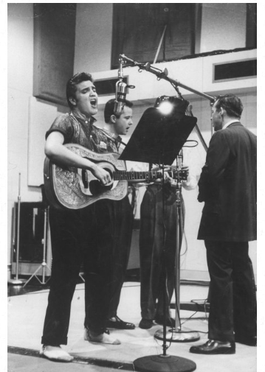
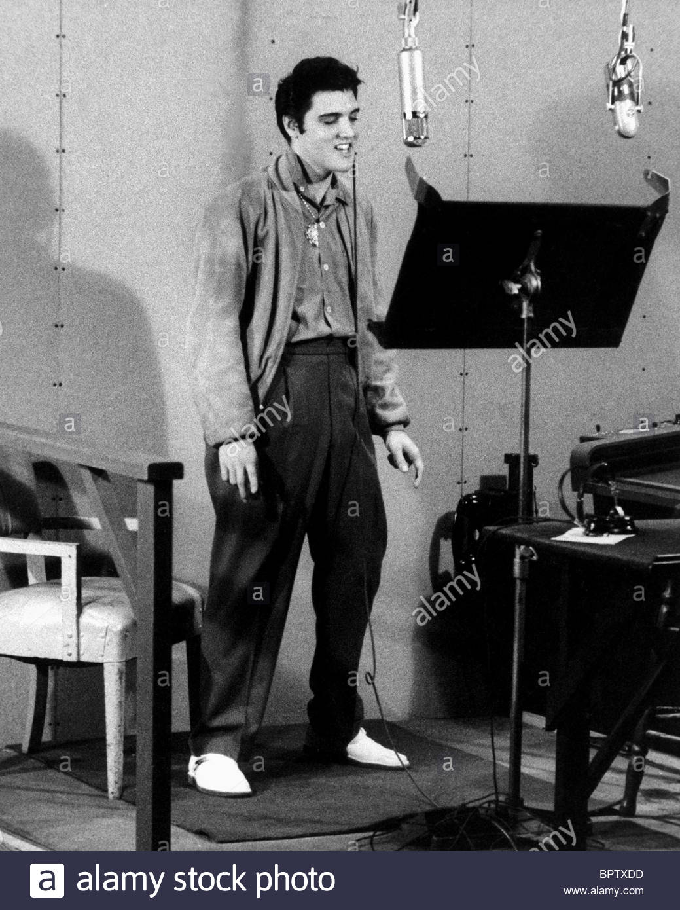
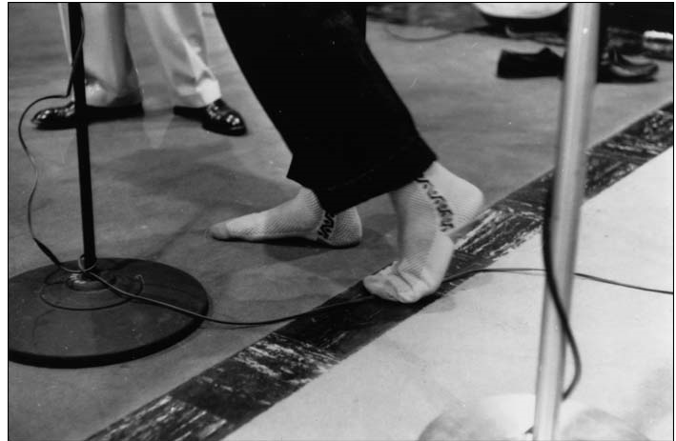
1.82 m

Slide 35
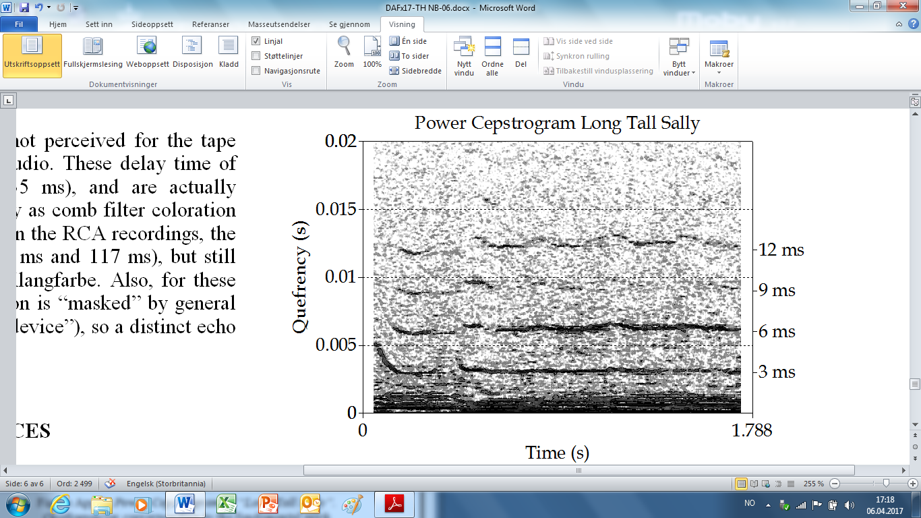
9.7 ms: a reflection?
Short delay time ≈ voice
Fundamental pitch in this short clip of Long Tall Sally ≈ 330 Hz,
Δt= 1/330=3 ms.
Power Cepstrogram of “Long Tall Sally”.
Quefrequencies corresponding to the fundamental
pitch indicated as the lowest number to the right
We do not see an additional, strong spike at 9.7 ms
A first indication that there is no strong, distinct floor reflection
with a delay of 9.7 ms. (also because 9.7 is close to 3x3=9 from the voice).
Eliminate the fundamental and overtones of the voice,
a Linear Predictive Coding (LPC);
exchanging Elvis´ voice chords with white noise as excitation.
The result sounds like Elvis whispering “Gon´na Tell Aunt Mary”.
Power Cepstrum of this sound file (unfortunately)
gave no clear indication of a strong, distinct reflection after
9.7 ms.
Autocorrelation of this is sound file shown in figure App.2.
We might see that there is a somewhat higher value for app. 9.7 ms,
but this is not very strong and also “smeared out” in time,
so if this was a floor reflection,
the singer must have moved his head somewhat
during the recording,
so that the distance from the floor changed over time,
a highly reasonable assumption for Elvis.
“wah-wah-pedal-effect”?.
Autocorrelation of
Linear Predictive Coding
of “Long Tall Sally” with
white noise as excitation.

Slide 36
CONCLUSION
SLAP BACK ECHOS, SUN STUDIOS
(Baby Let´s Play House, Tryin´to get to you)
single tape echo:
TIME DOMAIN
and not much comb-filter coloration MONO!!!!!!!!!
RCA recordings
(Heartbreak, Long Tall Sally)
Shorter Delay, Not so Distinct.,
MIGHT correspond to an echo in the length direction of a corridor with
length 27.2/2=13.6 m (if the sound travels to the «short wall» and back)
Tendencies of shorter repetitions (repetetive reflections each 9 ms),
that might PERHAPS be flutter-echo between side walls in a corridor with a width of app.3 m
Small tendency og Box-Klangfarbe
and the possible 9ms probably adds to the CloseRoom sound perceived as «intimacy»
137 ms
82 ms

