Slide 1
Measurement in reverberation room according to the reverberation time in real space
Erik Flink Ipsen ,Head of R&D, Knauf Danoline

Slide 2
Reverberation room vs. Expected reverberation time
For many years, Sabin’s formula has been leading for quantifying the absorbers necessary for calculation of reverberation time. The formula has also been used to determine the absorption profile of a product.
Together with Fraunhofer institute, Knauf has run a series of tests to compare sound absorption of different products; compare the absorption profiles with calculated reverberation times; and clarify the connection between the two through measurements in real environments.
Tests show a large difference – and the most parameter is the strategy for placement of absorbers, rather than just installing the calculated quantity.
Tests made at Fraunhofer, supported by the previous measurements made by SP Sweden, show that chamber measurements are not reliable for specifying quantity. But what can be used instead?

Slide 3
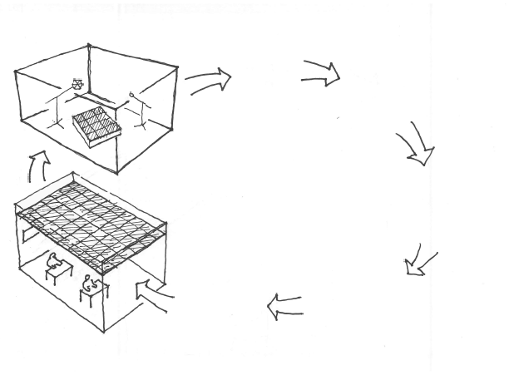
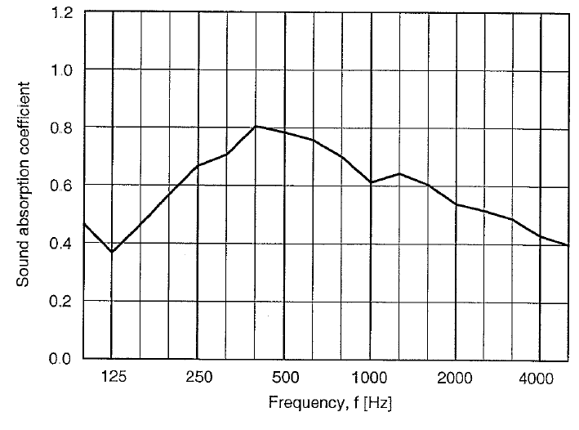
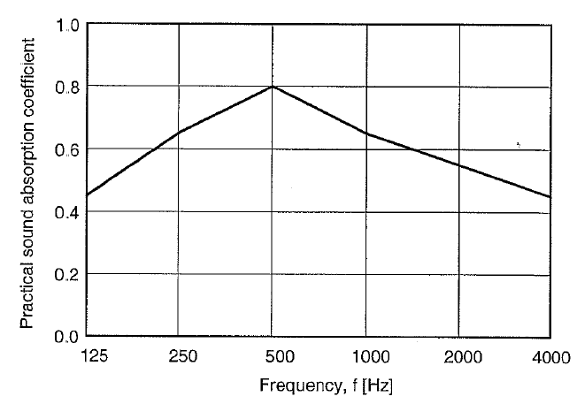
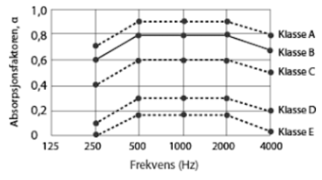

T = 0,16 x V / A
?
Do we reach the calculated expected reverberation time ?
T = 0,16 x V / A

Slide 4
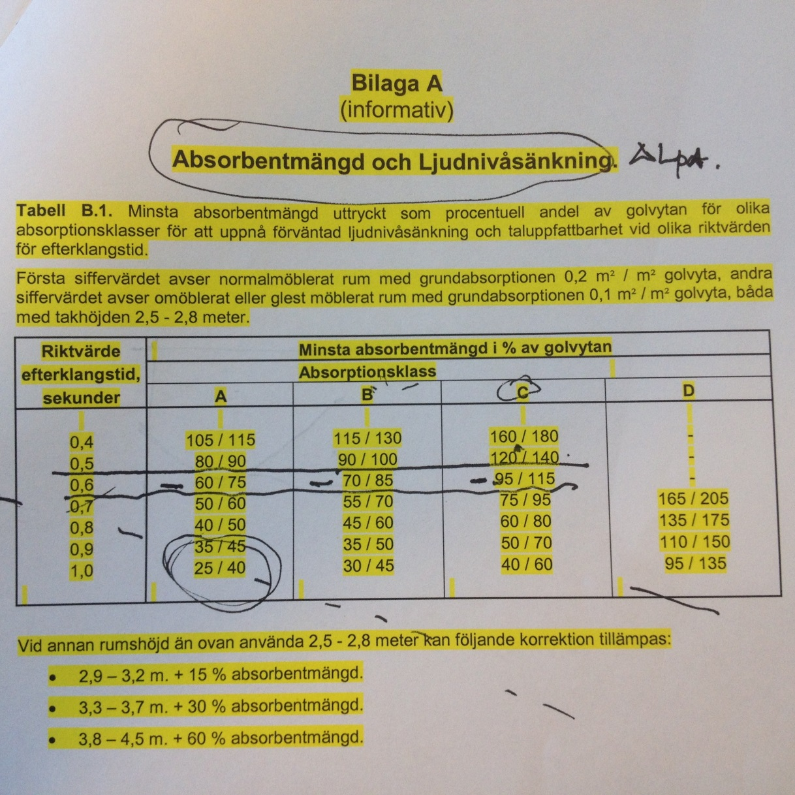
Can sound be simplified?
Swedish Standard 25268

Slide 5
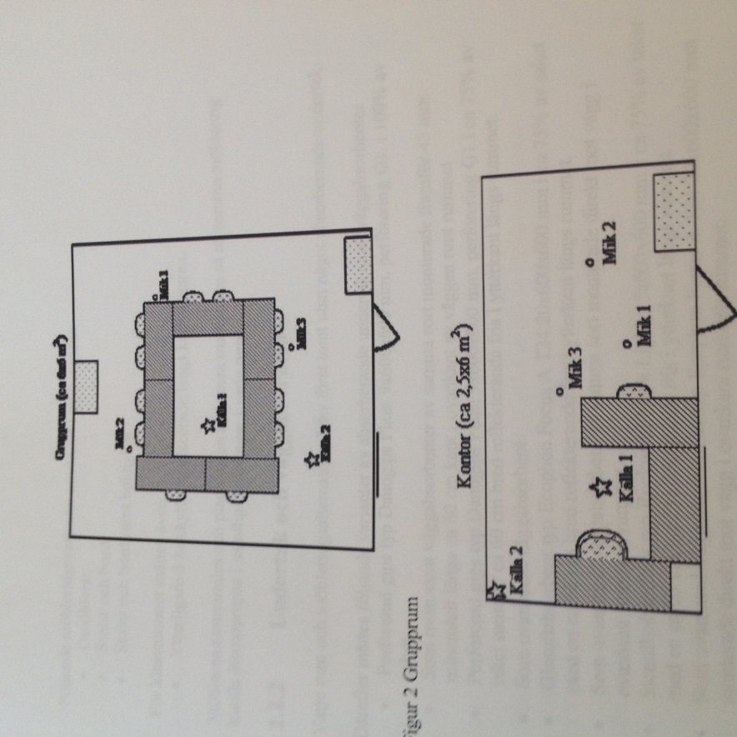
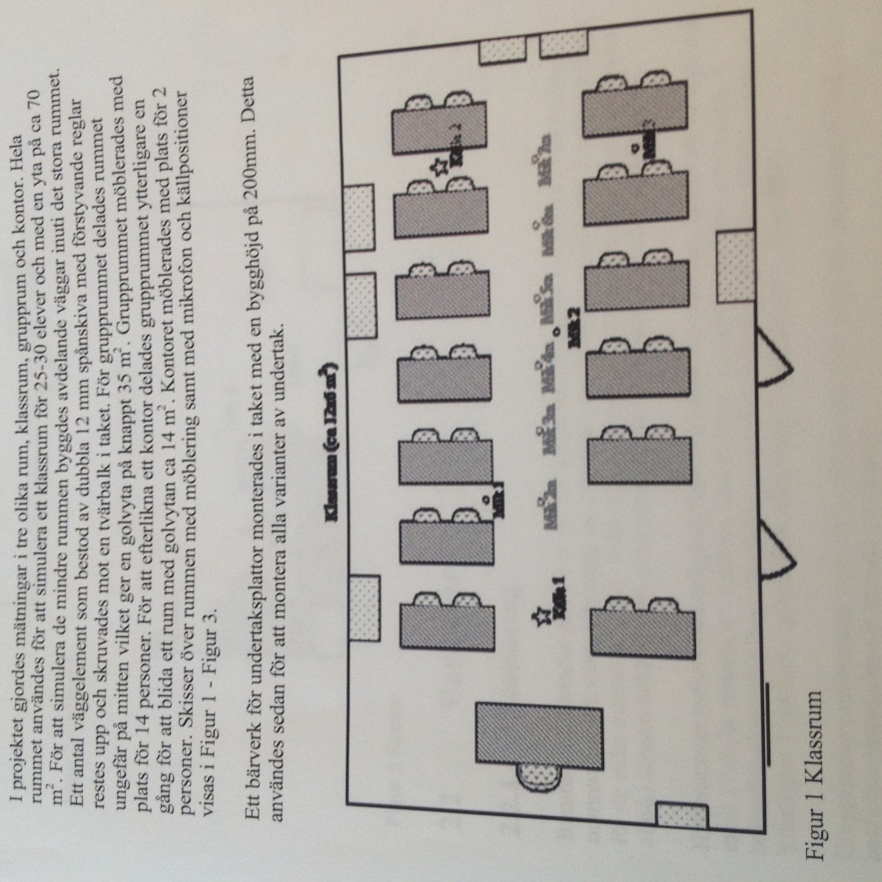
Reverberation time and absorption values are two different measures
SP measurement : 2006

Slide 6
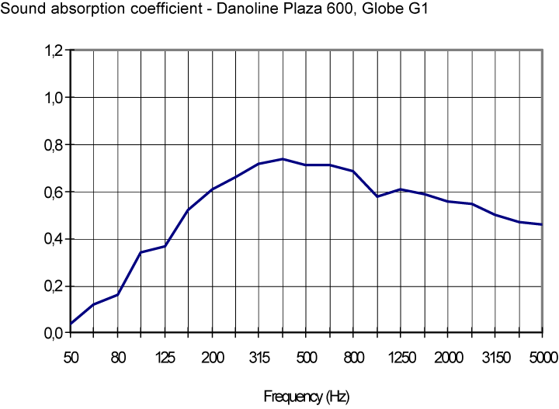
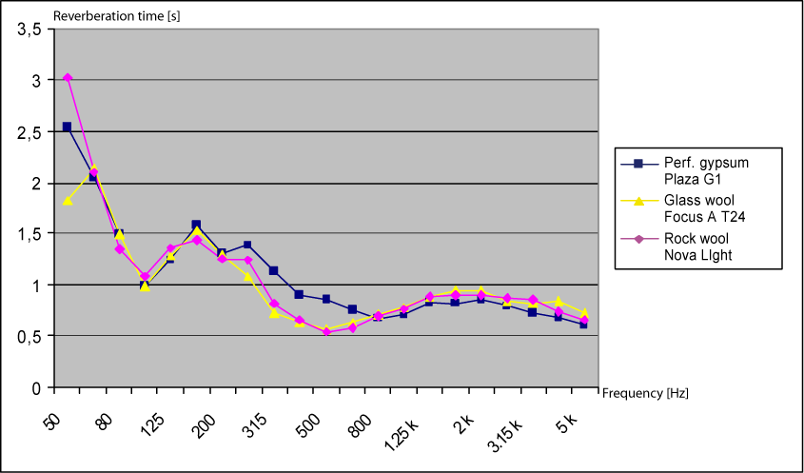
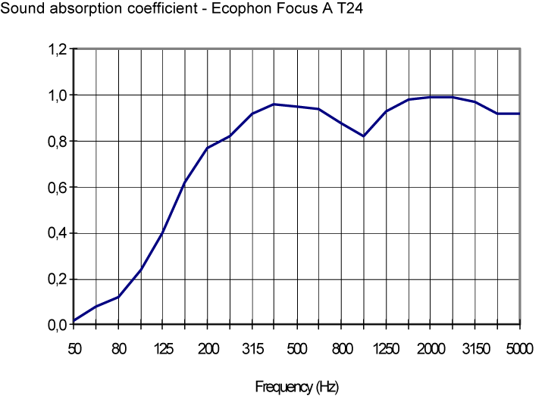
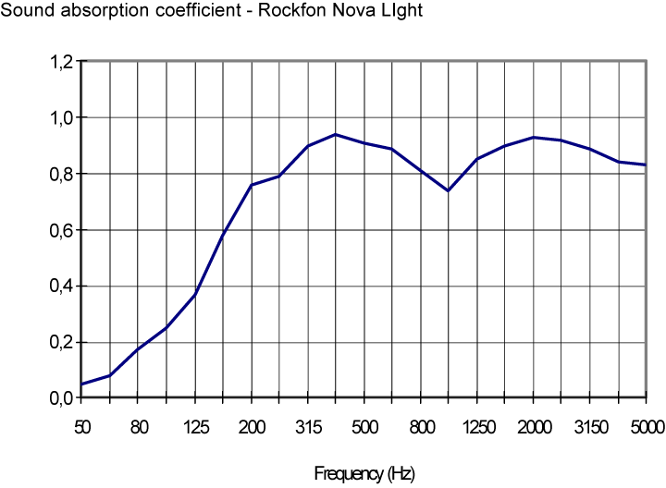
Very different absorption profiles show similar performance in real life
SP measurement : 2006
With different ceiling types; with furniture.

Slide 7
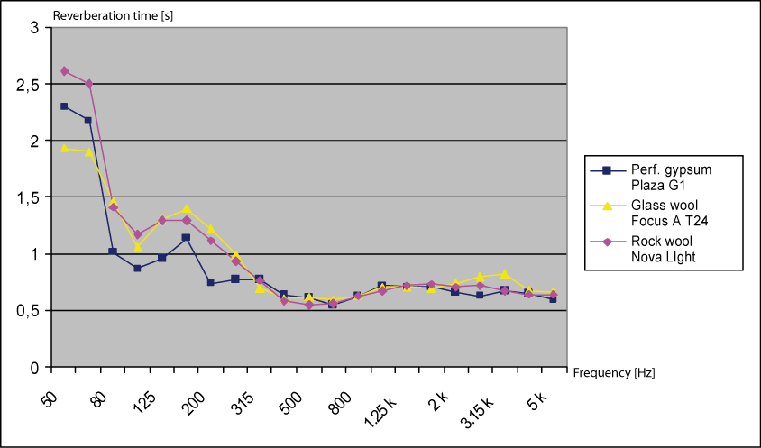
Wall absorbers and diffusion improve the performance of perforated ceilings the most
SP measurement : 2006
Different ceiling types, furniture and wall absorbers

Slide 8
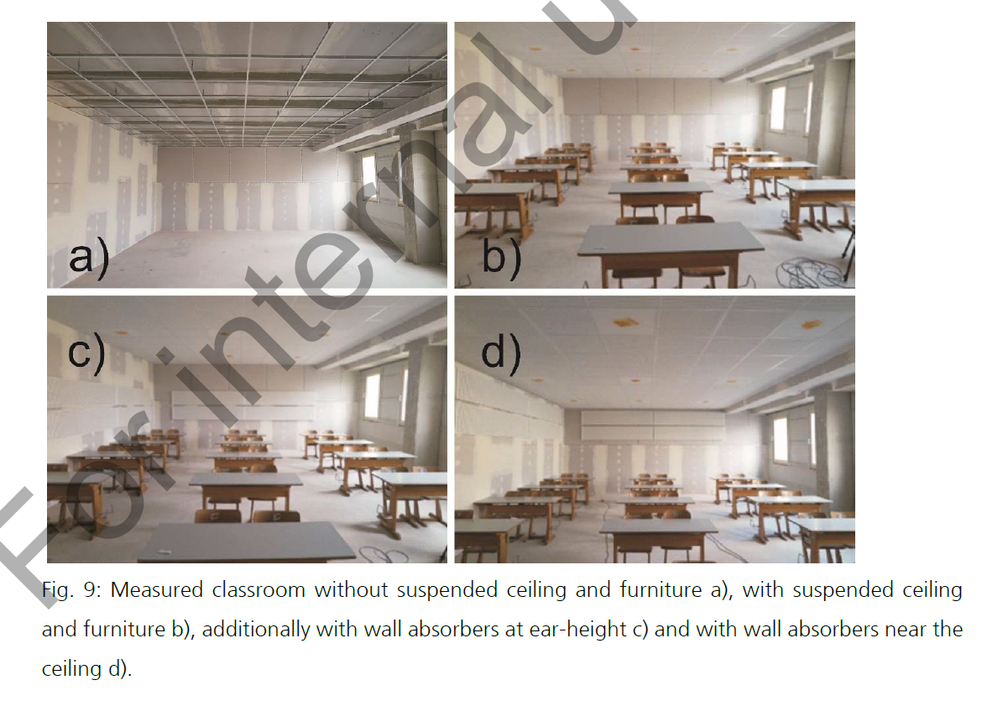
Testing continued with Fraunhofer institute – explaining the SP measurements
Room Size:
10 x 6,88 x 2,85 m
Volume:
196 m3
Acoustic Ceiling:
55,6 m2
Wall absorber:
18 m2

Slide 9
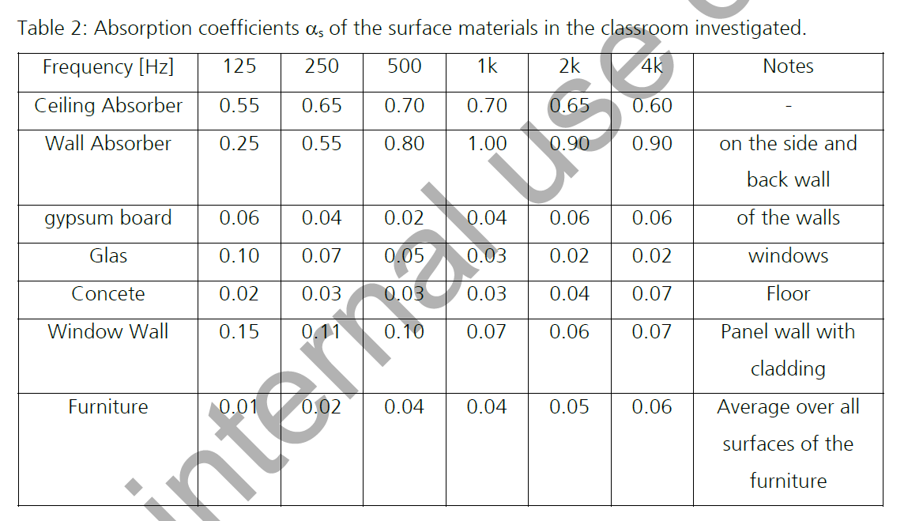
Measurement with Knauf Danoline Plaza G1 perforation

Slide 10
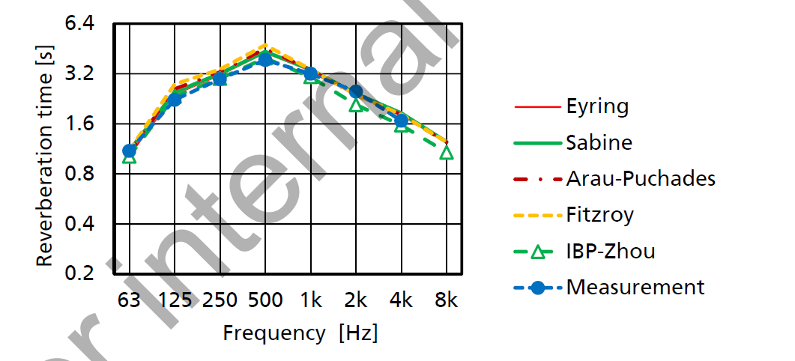
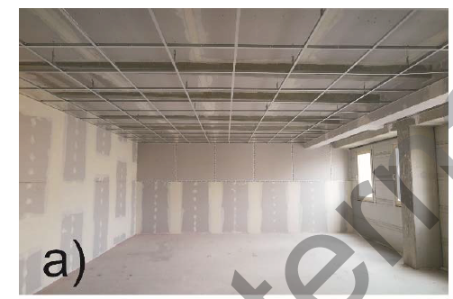
Empty room and different calculation methodes

Slide 11
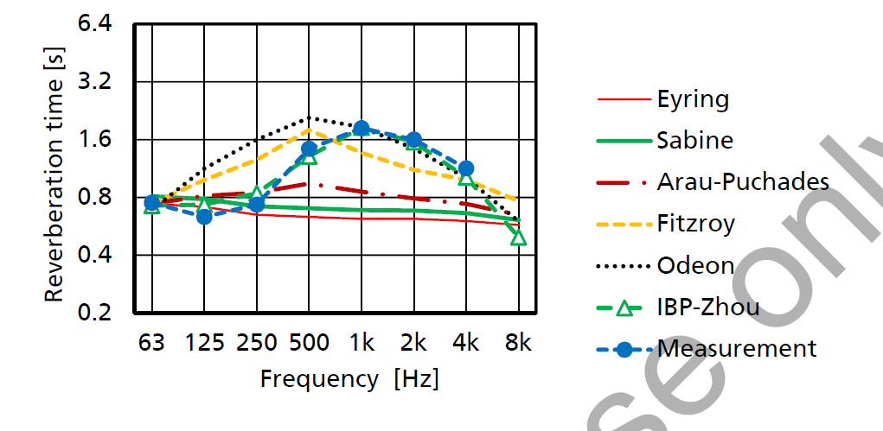
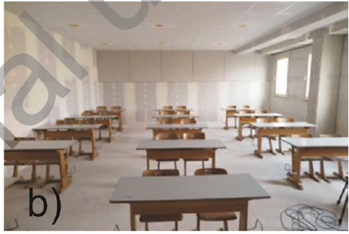
Room with furniture and acoustic ceiling

Slide 12
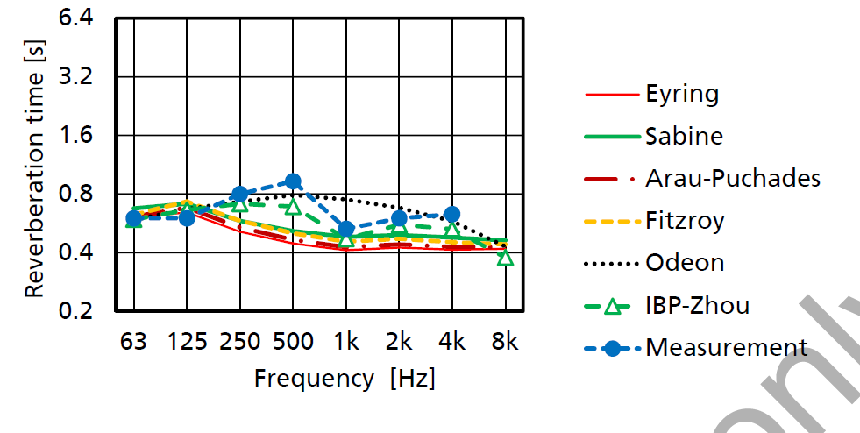
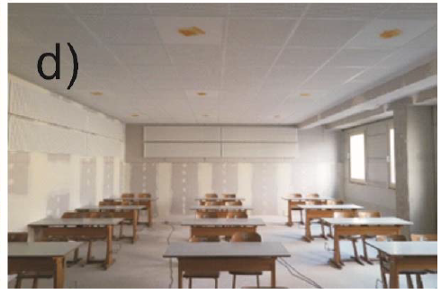
Room with furniture, acoustic ceiling and wall absorbers

Slide 13
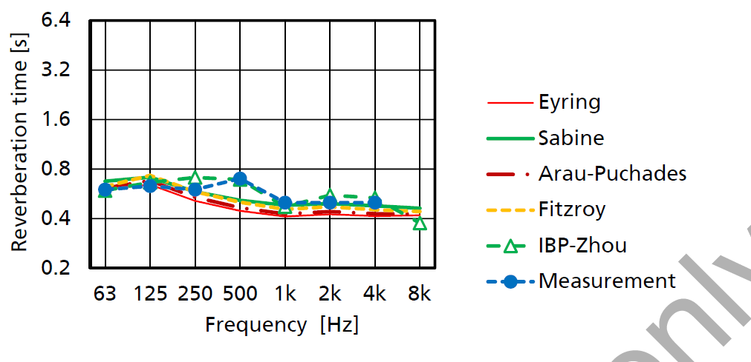
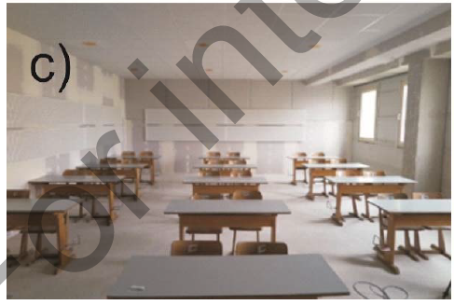
Furniture, Plaza Ceiling and ”earhigh” wall absorbers

Slide 14
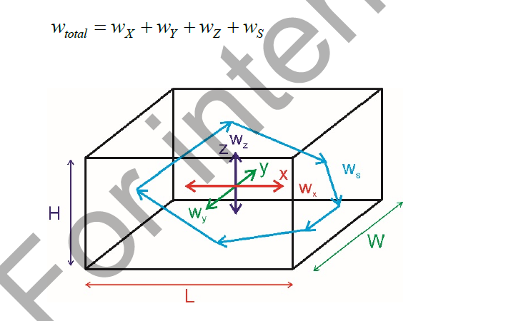
The 4 dimensions

Slide 15
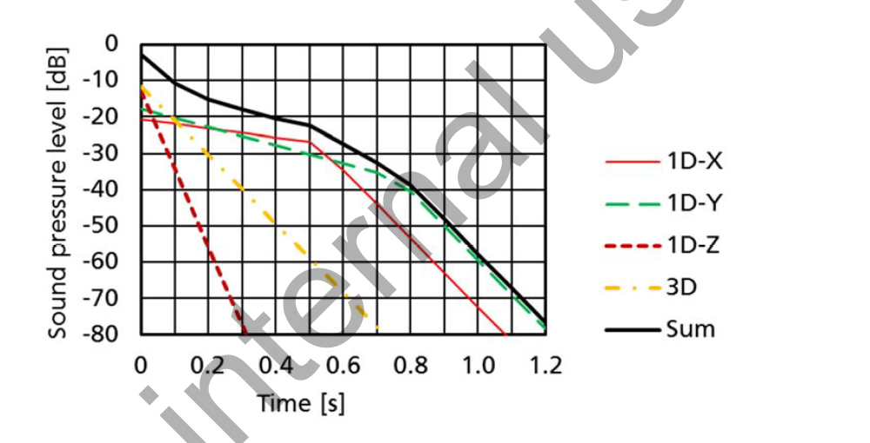
Reverberation time for the different surfaces

Slide 16
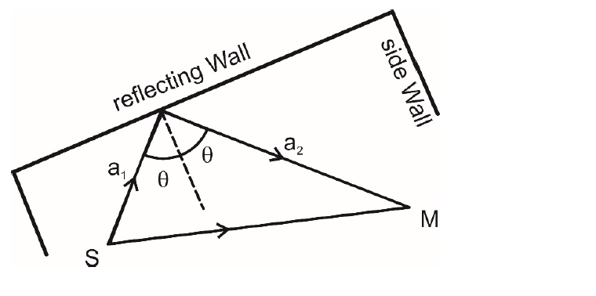
Placement of speakers and microphone

Slide 17
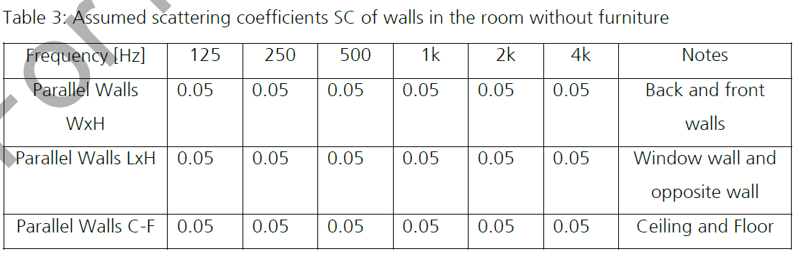
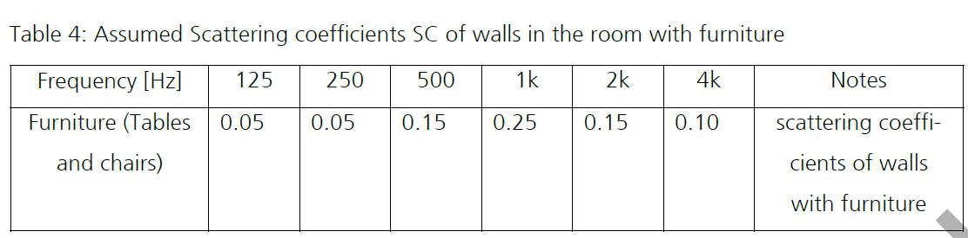
Scattering coefficients

Slide 18
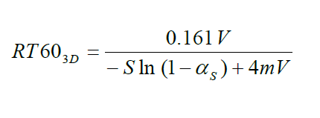
New formula for reverberation time ?

Slide 19
Does the new formula only affect perforated gypsum boards
Measured
Calculated

Slide 20
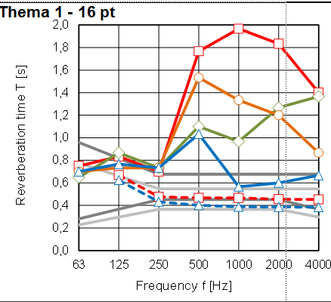
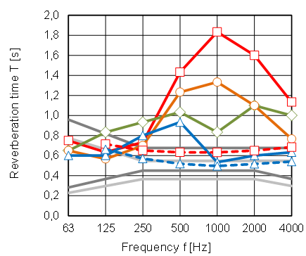
Is Sabin’s formula product depended ?
Mineralwool class A
Perforated gypsumboard Class C

Slide 21
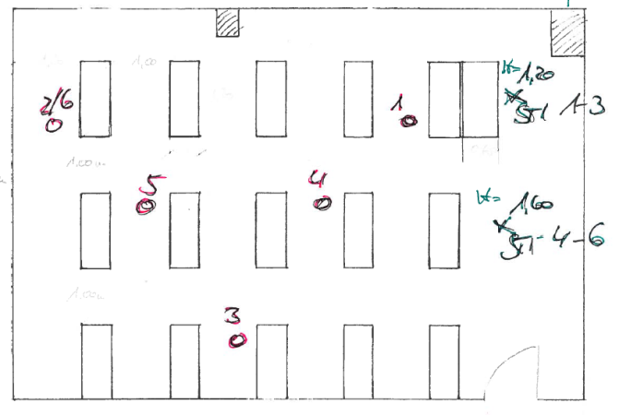
STI (wallabsorber + furniture)

Slide 22
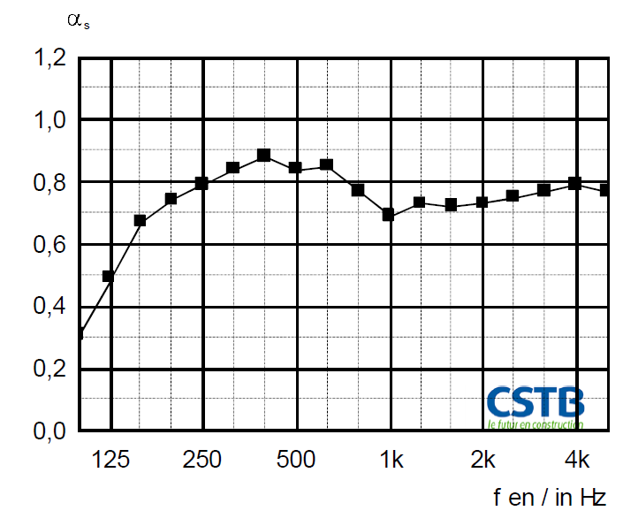
Comparision between perforated absorbers
G1 Globe perforation
U3 Unity perforation

Slide 23
Chamber measurements are not reliable for specifying quantity.
But what can be used instead?

