Slide 1
Sound insulation of massive wood floor constructions
NAS Høstmøte 2017, Trondheim
Jens Holger Rindel
Multiconsult, Oslo, Norway

Slide 2
Outline
Bending and shear waves
Modal density
Impact and airborne sound insulation of a massive wood slab
Experiments for improvement
Conclusion
Acknowledgements

Slide 3
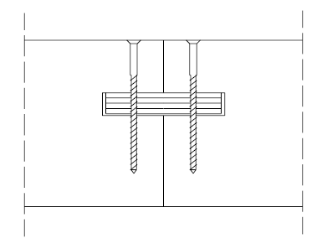
Massive wood as a floor construction

Slide 4
Bending and shear waves
Critical frequency (c_{B} = c = 344 m/s)
Crossover frequency (c_{B} = c_{S} = 344 m/s)

Slide 5
Orthogonal plate
h = 185 mm m = 87 kg/m²
E_{x} = 13 000 M Pa
c_{S,x} = 3 996 m/s
f_{c,x} = 59 Hz
f_{s,x} = 7 989 Hz
E_{y} = 460 M Pa
c_{S,y} = 752 m/s
f_{c,y} = 315 Hz
f_{s,y} = 1 503 Hz

Slide 6
Modal density
S = 3.37 m * 2.98 m = 10.0 m²

Slide 7
Modal density – low frequencies
 | Hz
f₁₁ | 57
f₁₂ | 90
f₁₃ | 145
f₂₁ | 195
f₁₄ | 223
f₂₂ | 228
f₂₃ | 283
f₁₅ | 322
f₂₄ | 360
f₃₁ | 424
Lower limit for statistical analysis: f₂₂ = 4 * f₁₁ = 228 Hz

Slide 8
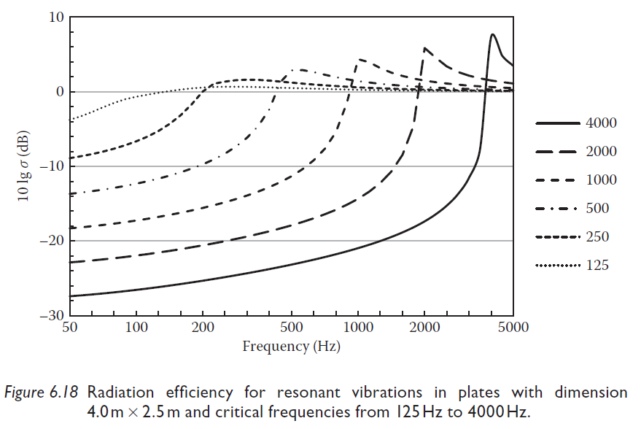
Radiation efficiency

Slide 9
Impact sound pressure level
0 or 1 mode per 1/3 octave
Like soft floor covering

Slide 10
185 mm massive wood
f_{cy} = 315 Hz
f_{cx} = 59 Hz
½ f_{s} = 1750 Hz
f₁₁ = 57 Hz
f₂₂ = 228 Hz

Slide 11
Sum of R and L_{n}

Slide 12
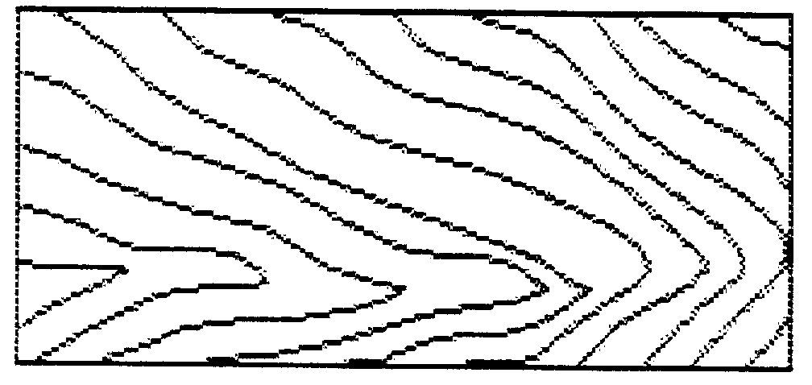
185 mm massive wood

Slide 13
Suspended ceiling

Slide 14
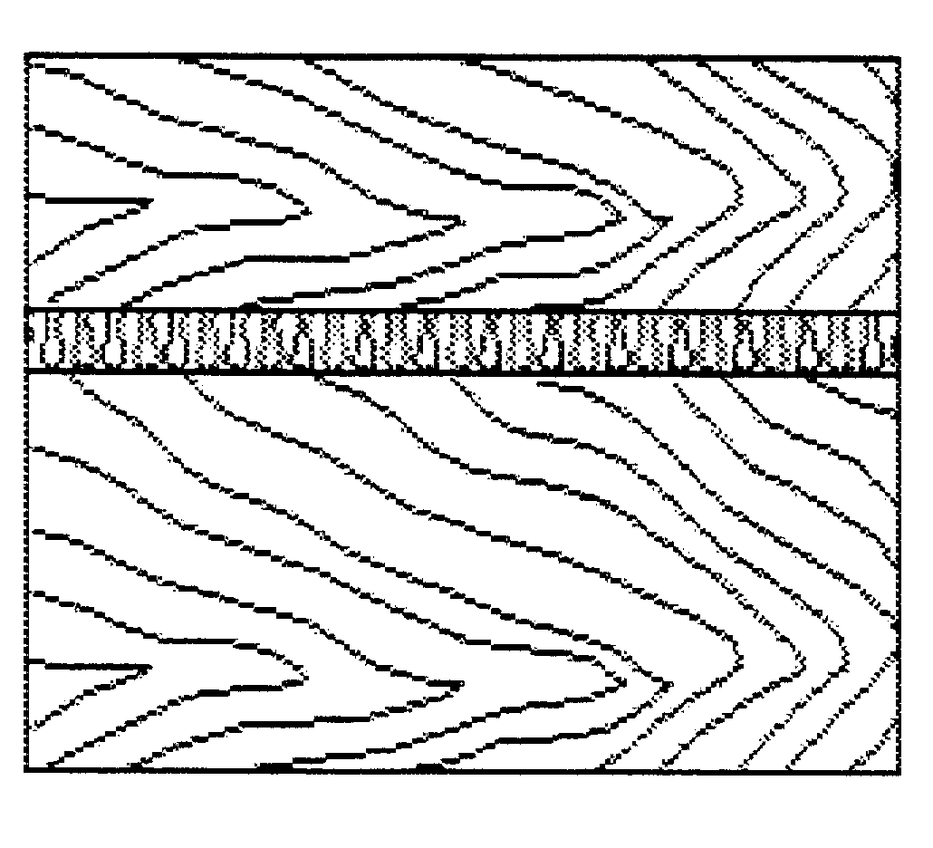
Floating floor

Slide 15
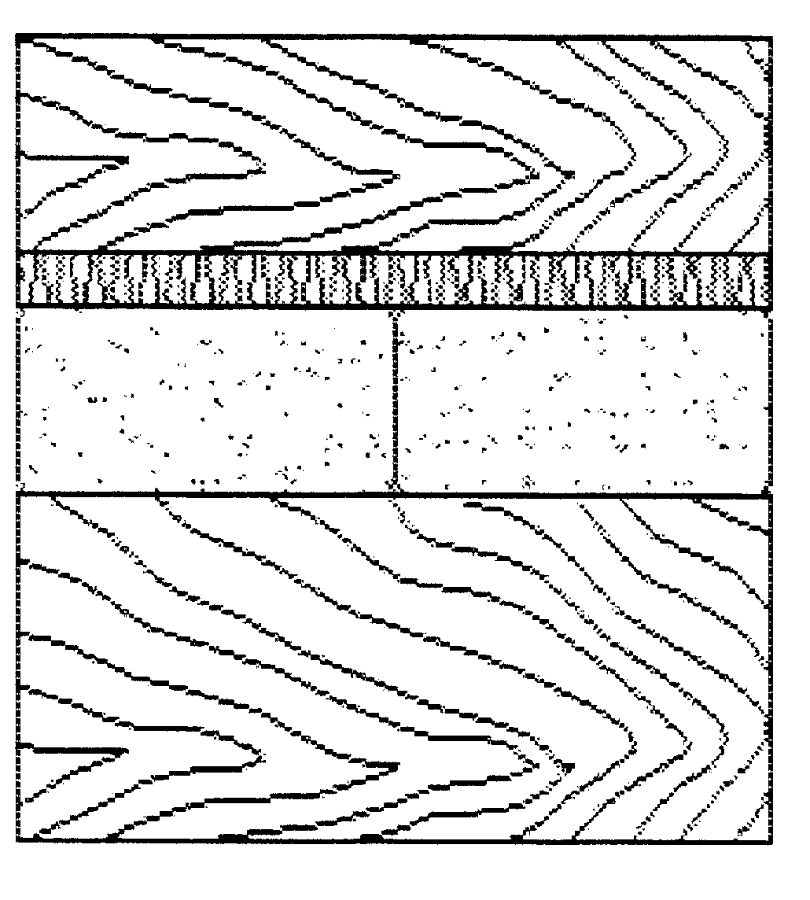
Floating floor + sand

Slide 16
ΔL_{n} - Floating floor w/wo sand

Slide 17
ΔL_{n} - Floating floor + suspended ceiling

Slide 18
Concrete tiles or sand under floating floor

Slide 19
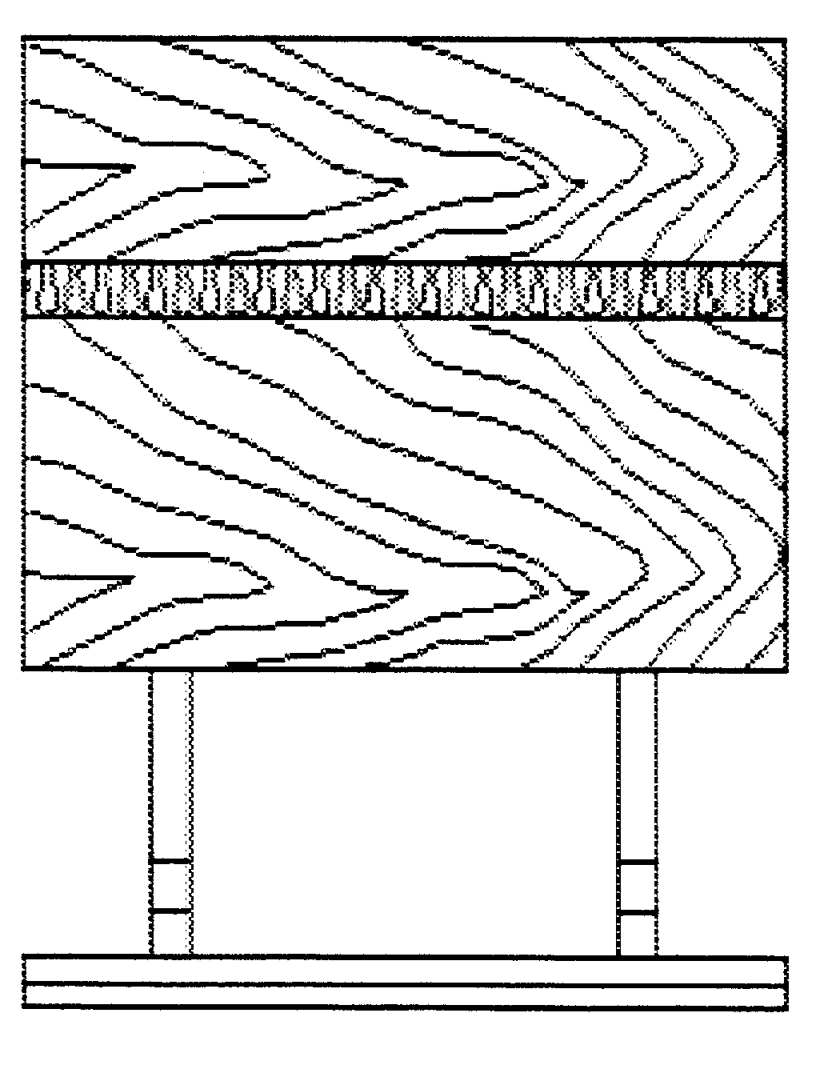
Construction | Description | R_{w} dB | R_{w,50} dB | L_{n,w} dB | L_{n,w,50} dB
 | 185 mm wood | 44 | 43 | 82 | 75
 | 115 mm wood - 30 mm mineral wool – 185 mm wood | 56 | 52 | 59 | 60
 | 185 mm wood - 150 mm suspended ceiling – 2*13 mm gypsum board | 62 | 59 | 50 | 57
 | 115 mm wood - 30 mm mineral wool – 185 mm wood – 150 mm suspended ceiling - 2*13 mm gypsum board | 63 | 59 | 41 | 53

Slide 20
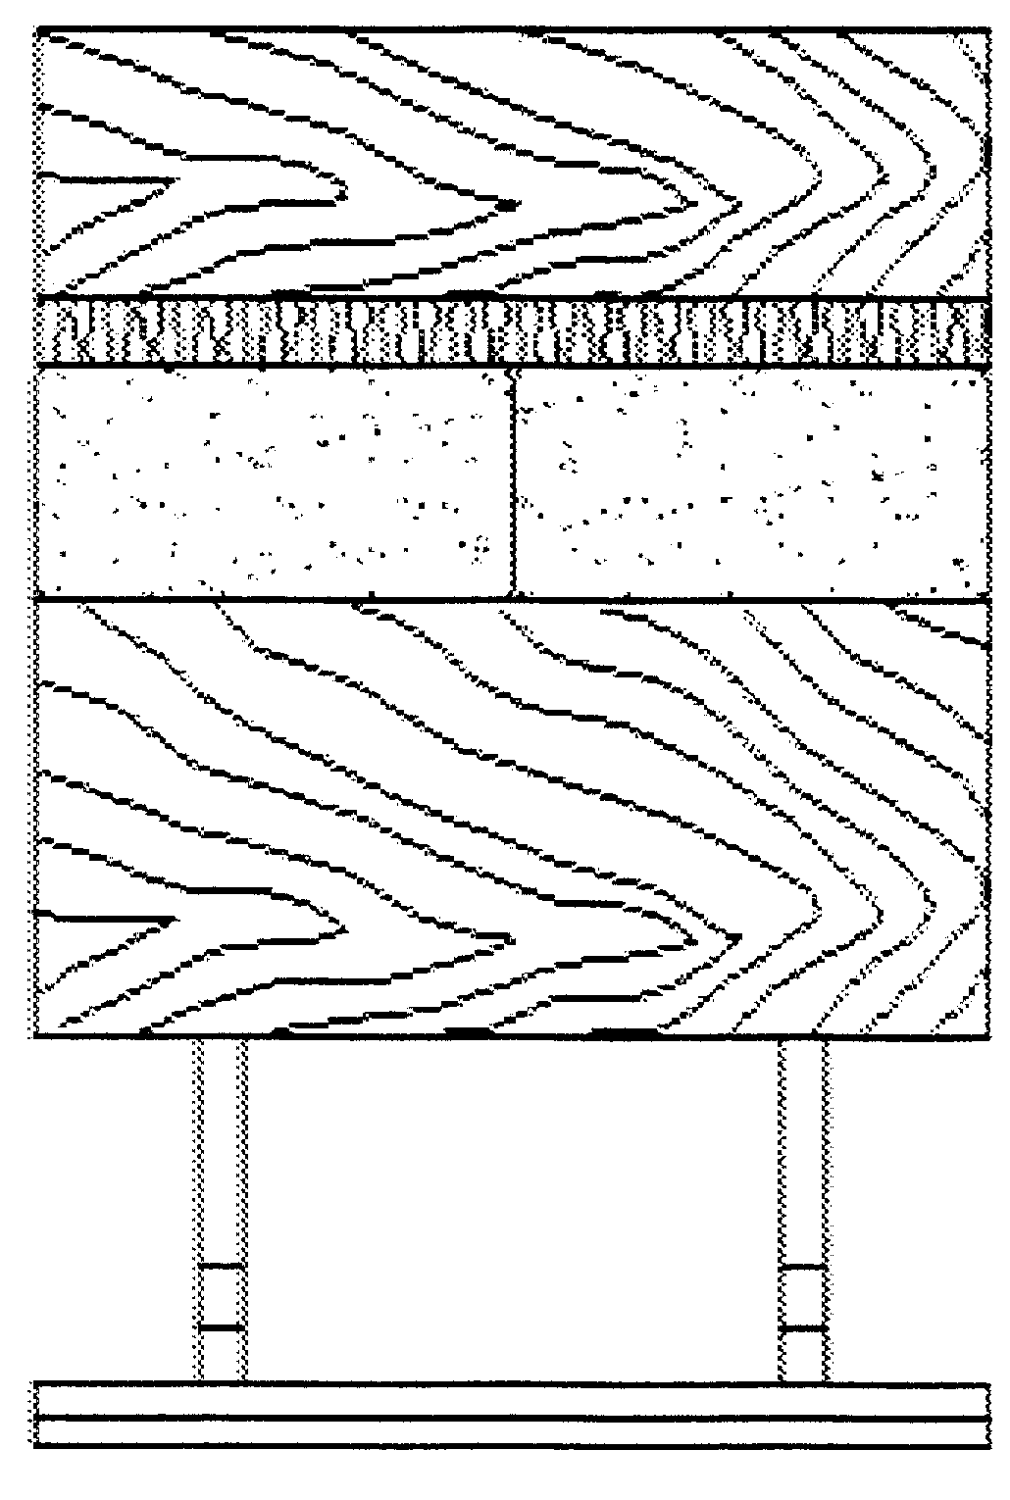
Construction | Description | R_{w} dB | R_{w,50} dB | L_{n,w} dB | L_{n,w,50} dB
 | 115 mm wood - 30 mm mineral wool – 50 mm concrete tiles (200*400) mm – 185 mm wood | 60 | 57 | 50 | 53
 | 115 mm wood - 30 mm mineral wool - 100 mm sand - 185 mm wood | 62 | 60 | 47 | 48
 | 115 mm wood - 30 mm mineral wool - 100 mm sand - 185 mm wood – 150 mm suspended ceiling – 2*13 mm gypsum board | 63 | 61 | 33 | 48

Slide 21
Conclusion
Massive wood slabs are theoretically complicated because of shear waves and orthotropy
A single massive wood slab is very far from meeting common sound insulation requirements
The combination of a floating floor of massive wood and a suspended ceiling has given good results in the laboratory (R_{w} = 63 dB and L_{n,w} = 41 dB)
A layer of sand and a floating floor of massive wood has also given good results in the laboratory (R_{w} = 62 dB and L_{n,w} = 47 dB)

Slide 22
Acknowledgements
The project was made by
  Louise Eriksen and Christine V.J. Ejlersen
  as a MSc projet at BYG-DTU in co-operation with Lilleheden Advance A/S.
  Supervisors:
  Aage Peter Jensen, BYG-DTU
  Per Oluf H Kjærbye, BYG-DTU
  Jens Holger Rindel, Ørsted-DTU
  Thesis:

